Slide 1

FLIGHT PRICE PREDICTION

Slide 2
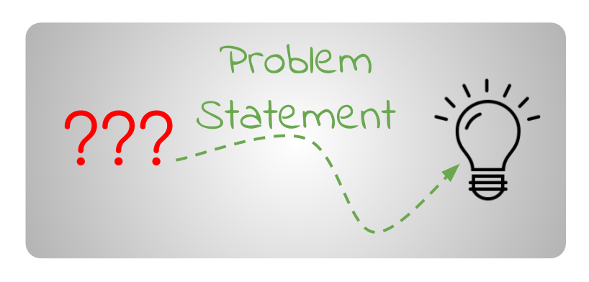
Problem Statement

Slide 3

Flight ticket prices can be something hard to guess, today we might see a price, check out the price of the same flight tomorrow, it will be a different story.
Our Aim is to address this unpredictability.

Slide 4


Type of flight ticket purchasers
Early purchasers
Last-minute purchasers
Generally can wait some time to find the best deal on a flight, but often will simply buy a relatively affordable ticket, since predicting when the lowest price point is can be too difficult.
Often pay full price for a ticket and do not have the flexibility of waiting for cheaper deals. As a result, prices will tend to spike radically within a few days of a flight, since airlines know some consumers have no other option

Slide 5
Factors affecting Price fluctuations
Keeping the flight as full as they want it
Destination Popularity
raising prices on a flight which is filling up in order to reduce sales and hold back inventory for those expensive last-minute expensive purchases)
Airlines always are trying to maximize their profit based on the forecast demand for a destination

Slide 6
Factors affecting Price fluctuations
Flight Closures
Economic realities, airline mergers and global events can sometimes cause aircraft to be removed from service. When this happens, overall capacity for a route is reduced, leaving fewer seats to be filled. Airlines will thus suspect that flights will be fuller and will increase ticket prices.

Slide 7

Problem in hand
1.Analysing the data to find out:
Frequency of change in Air flight prices
Movement of fare is in small increments or in large jumps
Movement goes up or down over time.
the best time to buy so that the consumer can save the most by taking the least risk?
Relation of booking date to departure date
Is Indigo cheaper than Jet Airways
Are morning flights expensive
2.Building a model to predict the Air Fare of various Flights for Early purchasers, to find the cheapest prices

Slide 8
Technology Used for the Project
Hardware technology being used.
RAM : 8 GB
CPU :Intel® Core™ i7-10510U CPU @ 1.80GHz
Software technology being used.
Programming language : Python
Distribution : Anaconda Navigator
Browser based language shell : Jupyter Notebook
Libraries/Packages specifically being used.
Pandas , NumPy, matplotlib, seaborn, scikit-learn, pandas-profiling, missingno

Slide 9
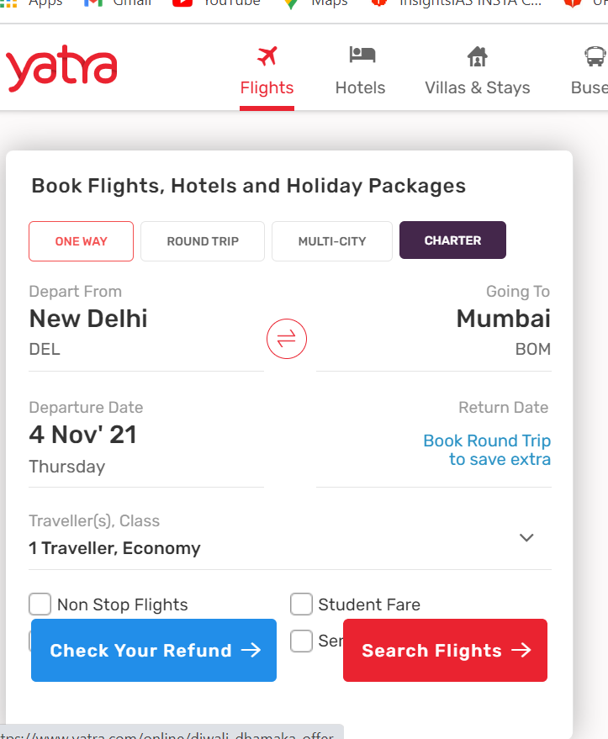
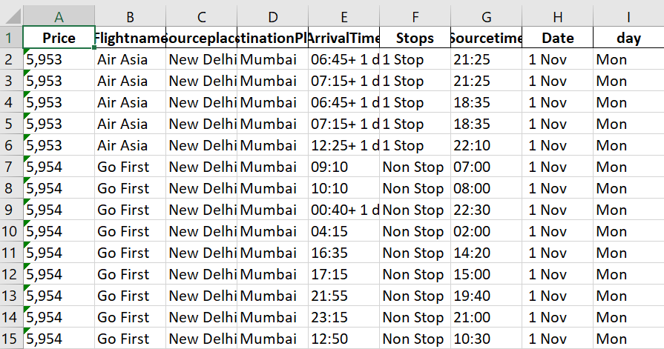
Data Mining
Data mined from Yatra.com
New Delhi to Mumbai flights were chosen as it’s the busiest route
Data was mined and stored in Excel sheet

Slide 10
Feature engineering
Splitting date and month in Date column
Extracting Hours and Minutes
Changing datatype of price into Integer format

Slide 11
Exploratory data Analysis
checking null values
FILLING THE EXTRA DAY null values WITH "no extra day"
Dropping duplicates
checking for outliers

Slide 12

Data visualization and analysis

Slide 13
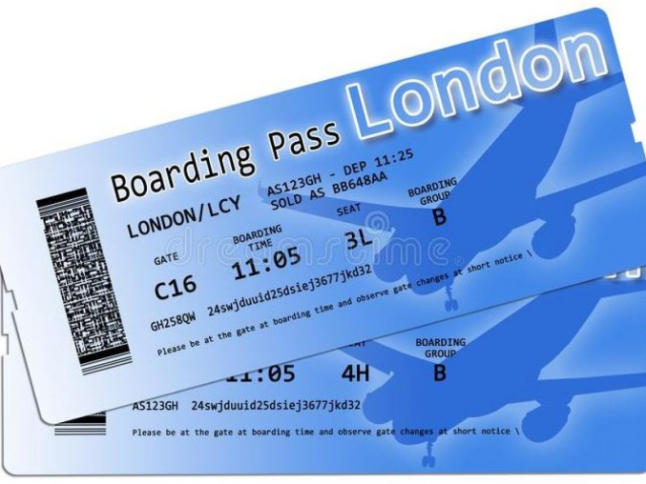
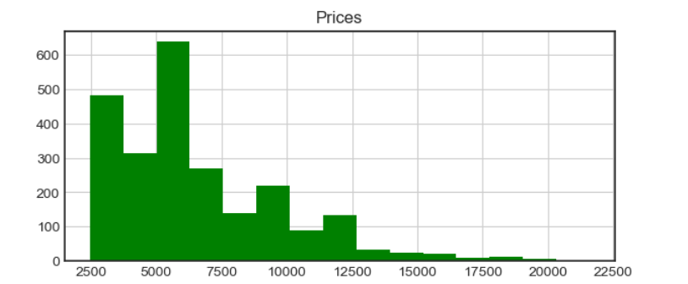
Price of the Fare
We are able to see that most of the flight price values are accumulated between 2500 and 12500 and very rare data points are distributed above that number.

Slide 14
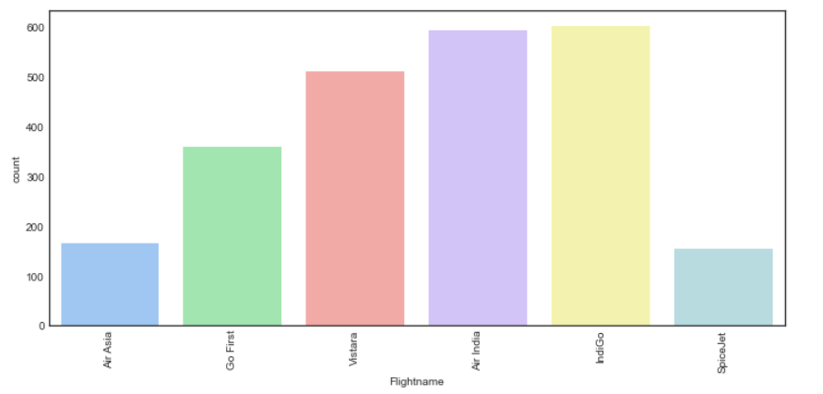
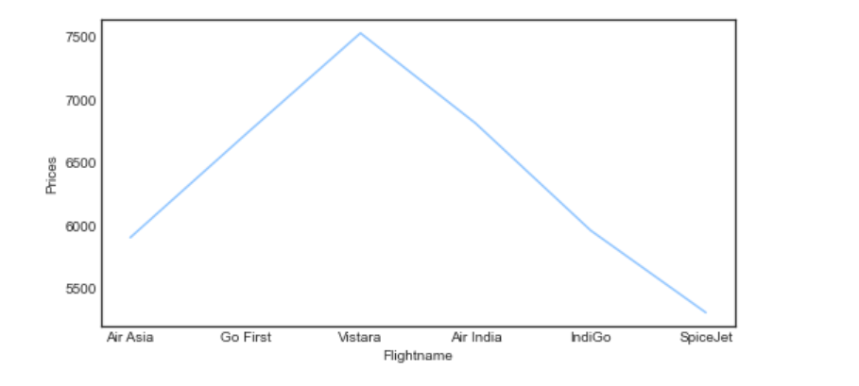
Flights
.Maximum number of flights are of Air India and Indigo
Vistara shows having the highest price

Slide 15
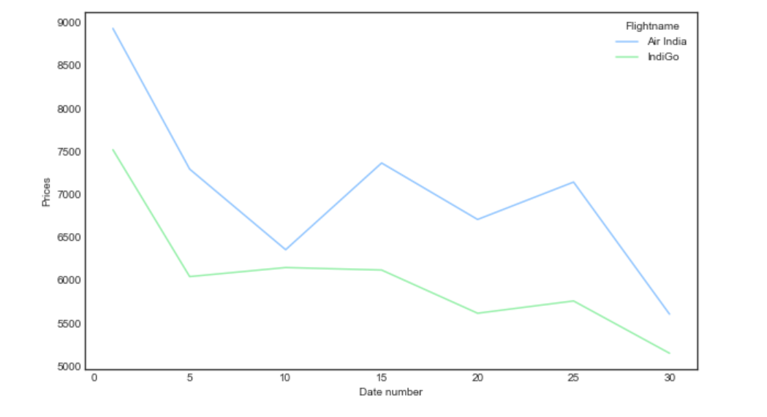
Indigo flights are cheaper than AirIndia

Slide 16
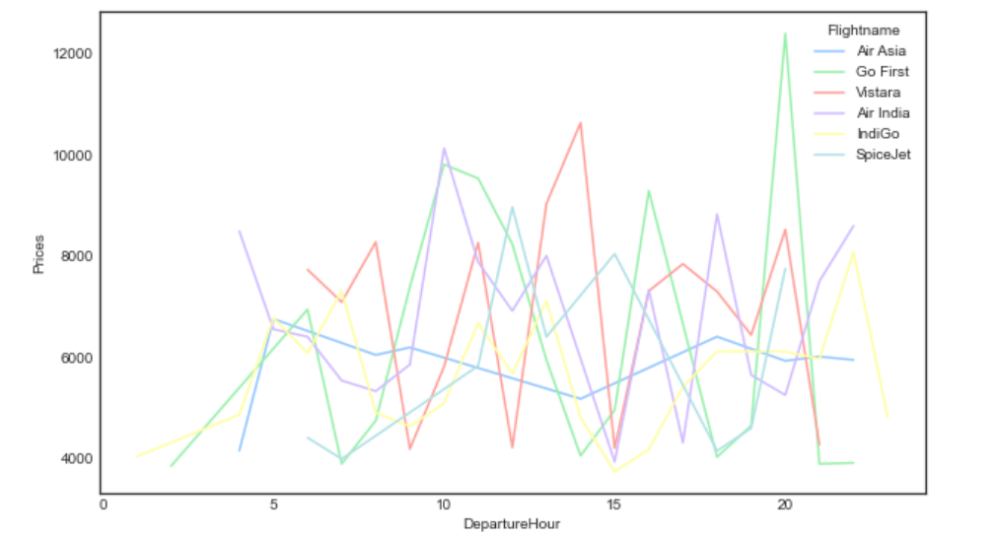
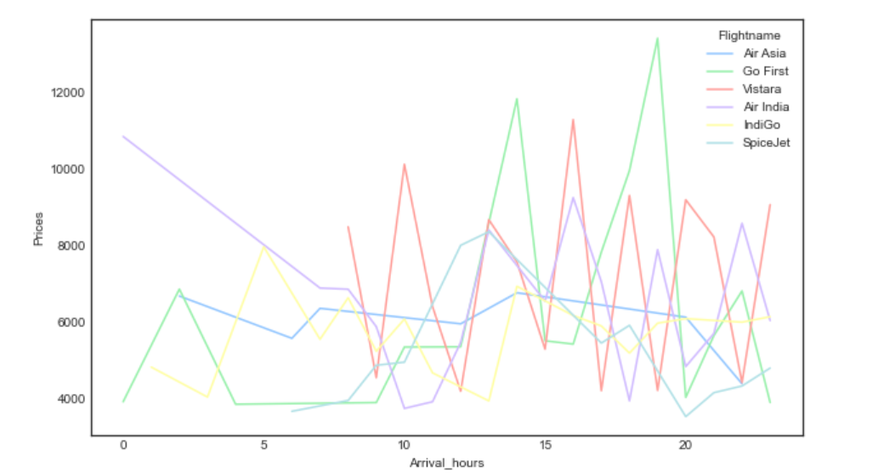
Departure hour of flights vs Price of Fare
Arrival hour of flights vs Price of Fare
Arrival and Departure at 8pm Has highest Fare Price
5am to 10am arrival has lowest Price

Slide 17
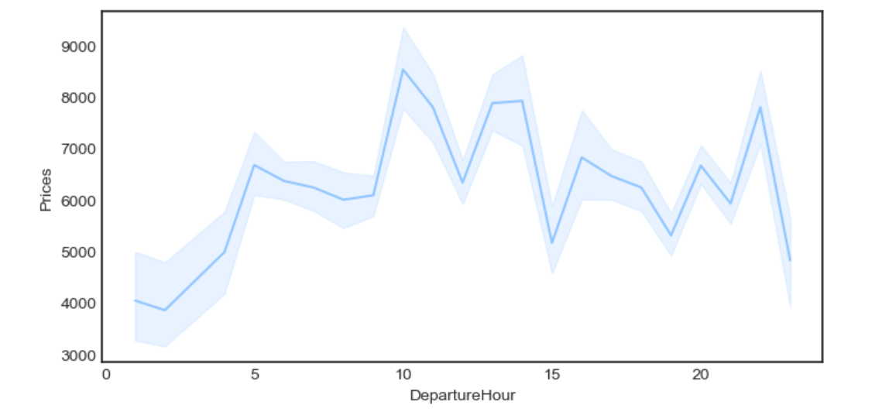
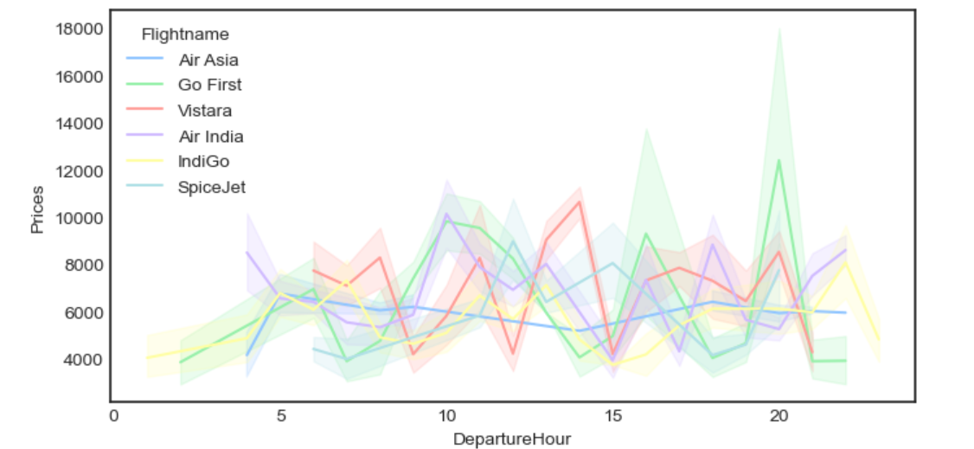
Morning vs Afternoon vs Evening
Prices are lower in the morning than in the afternoon and evenings

Slide 18
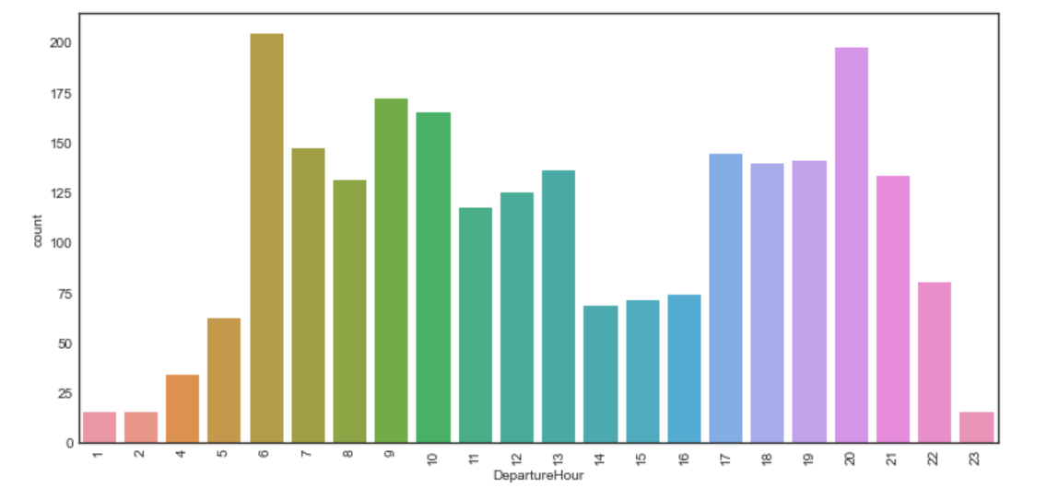
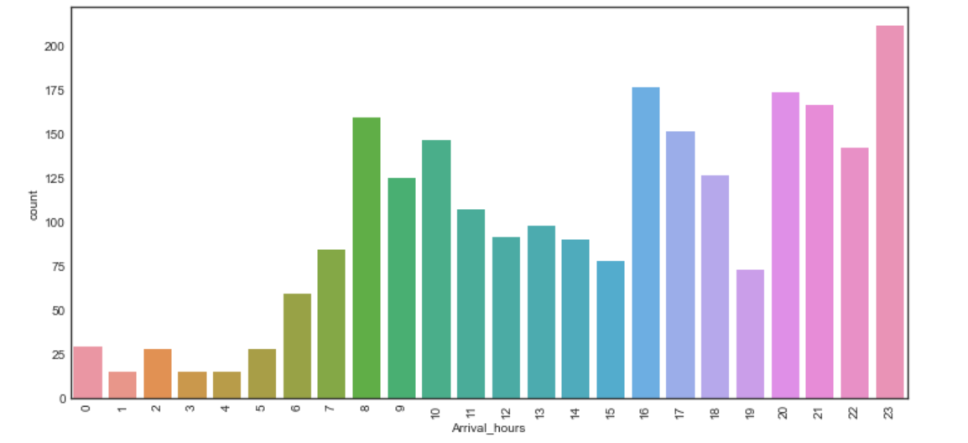
Departure hour of flights
Arrival hour of flights
Maximum flights take off between 6am-10am and 5pm to 9pm
Most of the flights arrive between 8am to 10am and 4pm to 11pm

Slide 19
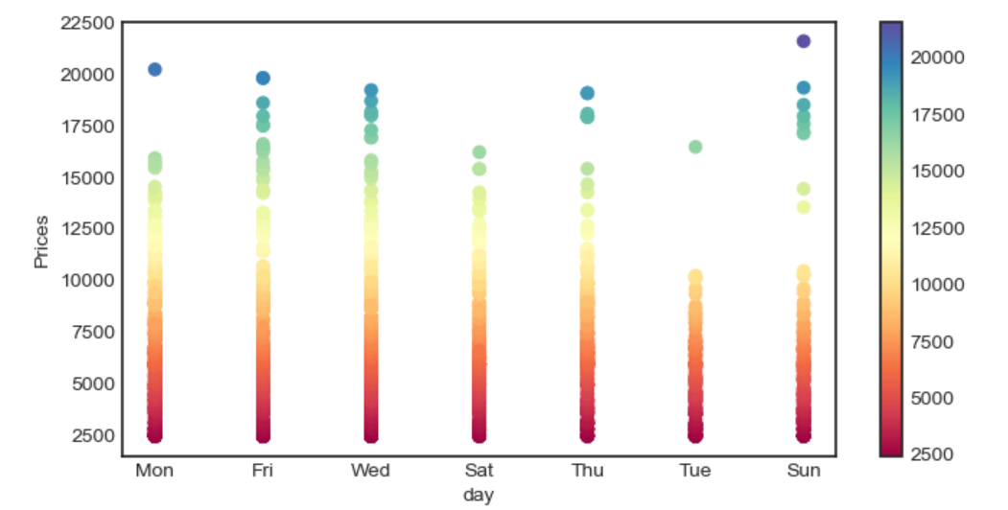
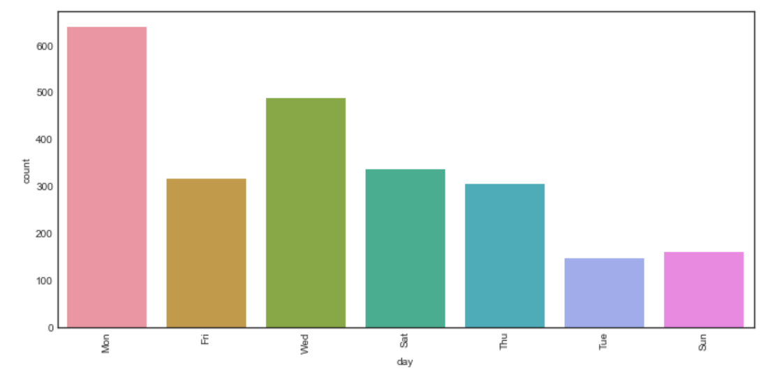
DAY OF WEEK FLIGHT DEPARTS
Maximum number of flights are taken on Monday
Highest prices is for Fridays,wednesdays and sundays

Slide 20
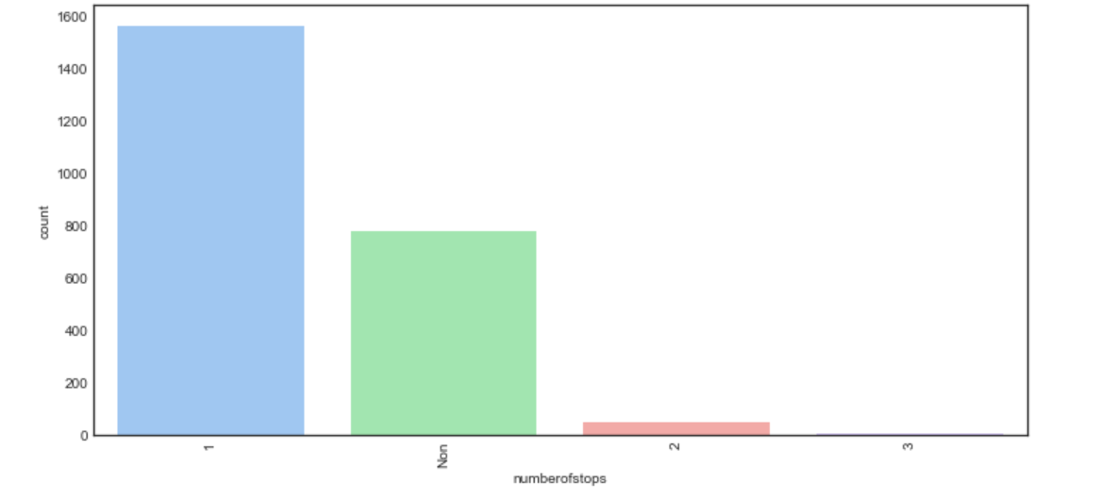
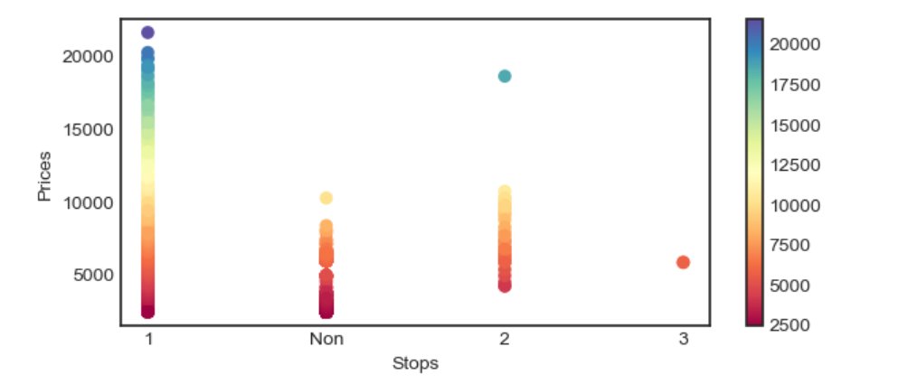
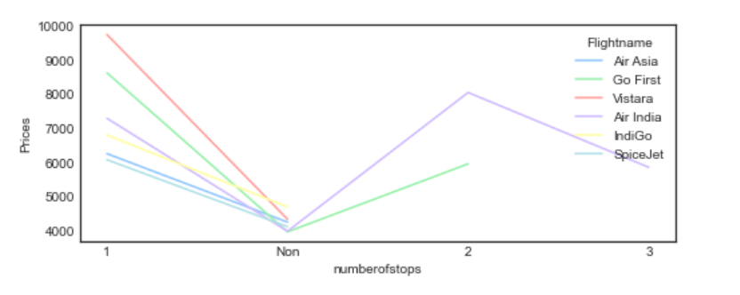
Number of stops
1 stop is more than no stop flights
The maximum prices are seen for 1 stop and lesser for non stop
minimum flights have 3 stops

Slide 21
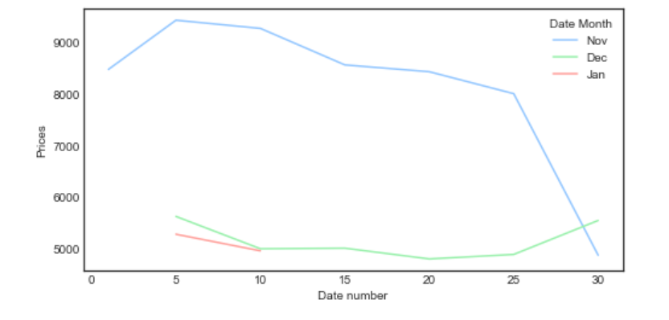
Price – Month Wise
Data collected are of November, December and January months.
Prices are seen to be higher till November 25th, the data was collected on october 30th. It shows a 30ay gap will cause the price to fall
There shows to be a steep fall in prices after 30 days.
Prices are seen to be decrementing in small intervals till 30days and in steep interval after 30days of booking date
Prices are also seen to be increasing as we book near to the departure date

Slide 22
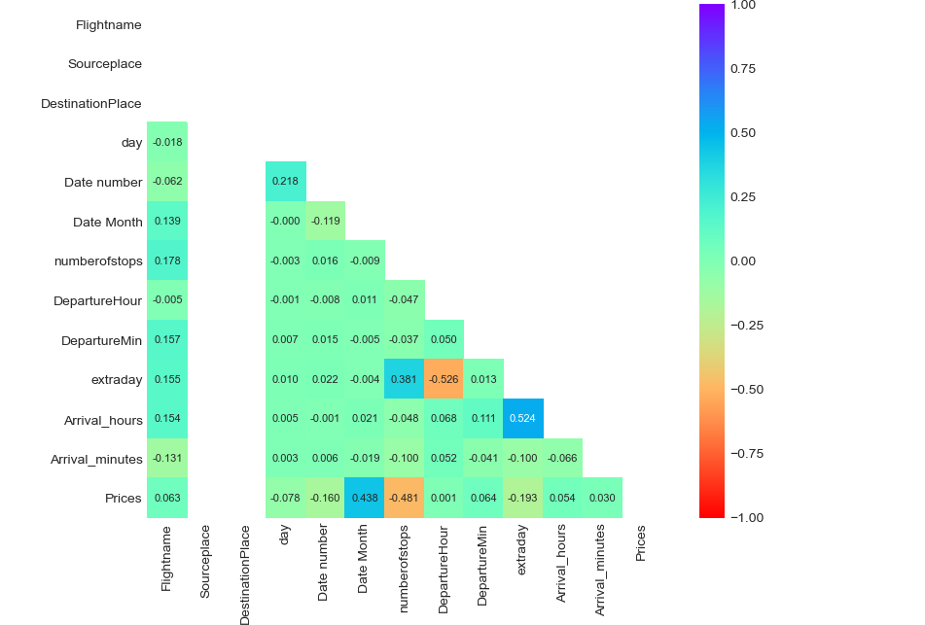
Heat map
there are no multi collinearity concerns in our dataset

Slide 23
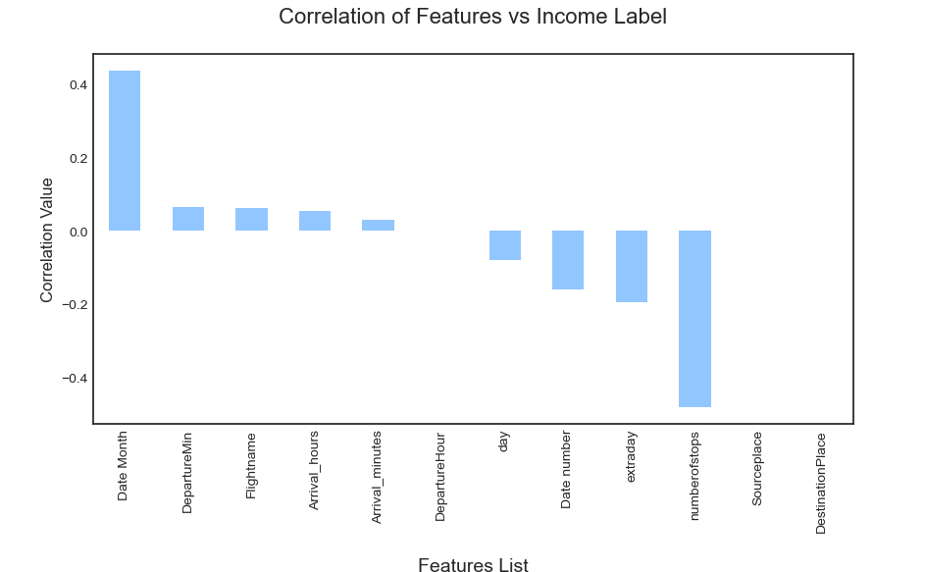
We can see that columns Date Month,DepartureminFlightname,arrival_hours and arrival_minutes are positively correlated with our target.
Date Number,extra day and numberofstops are negatively correlated where numberofstops is highly negatively correlated indicating that as the number of total stops in an itinerary increases the price of that particular flight increases and vice a versa

Slide 24
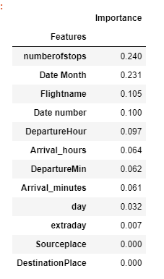
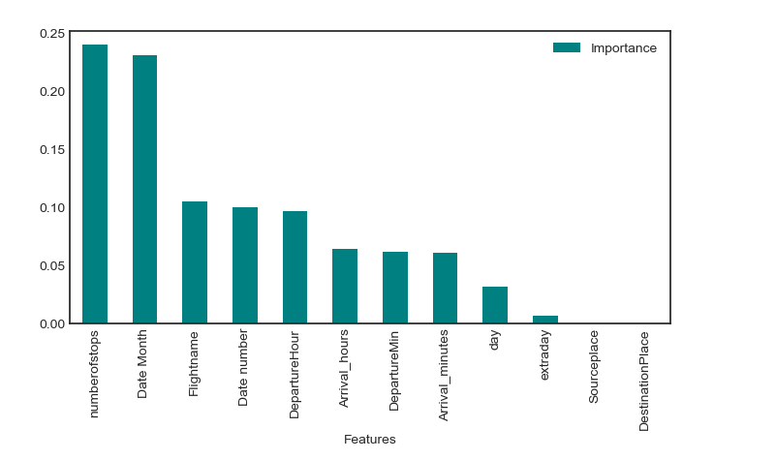
Feature Importance
weightage in predicting our label.

Slide 25
Machine Learning Models used for regression
Support Vector Regression
K Neighbors Regressor
Linear Regression Model
Ridge Regression
Decision Tree Regressor
Gradient Boosting Regressor
Lasso Regression
Random Forest Regressor
Ada Boost Regressor
Extra Trees Regressor
XGB Regressor
LGBM Regressor

Slide 26
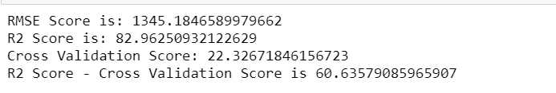
XGB regressor is chosen as best model since it is able to provide me the highest R2 score plus the model is doing better in Cross validation score too. However the LGBM model is not chosen even though it has high score and low difference between r2 score and cross val score is because LGBM algorithm is better for datasets above 10,000 rows

Slide 27
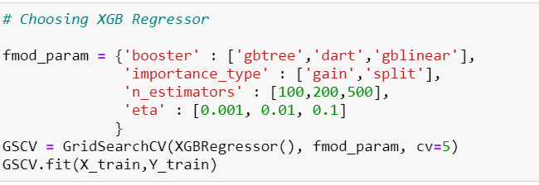
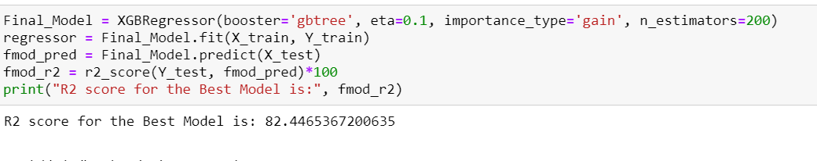
Hyperparameter tuning is done on best model and 82% r2 score obtained

Slide 28
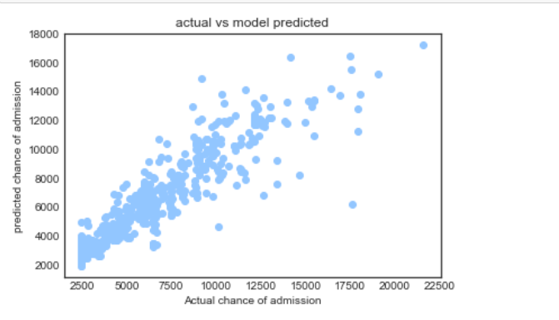
Finalised model with 82% r2 score

Slide 29
Thank you
Have a nice day

